Slide 1
Deep Neural Networks
Getting your matrix
dimensions right

Slide 2

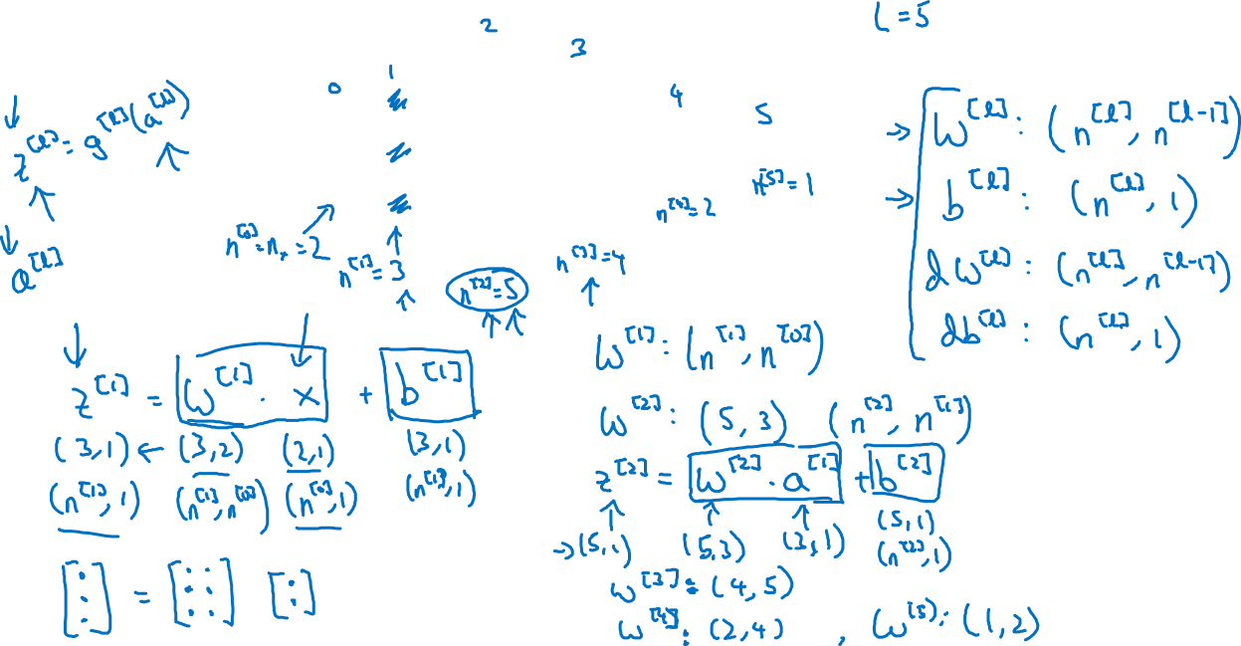



Parameters $W^{[l]}$ and $b^{[l]}$
$$x_{1}$$
$$\hat{y}$$
$$x_{2}$$

Slide 3
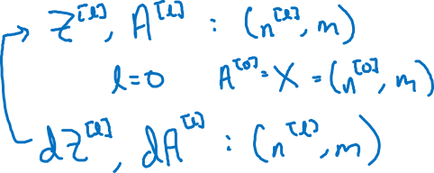
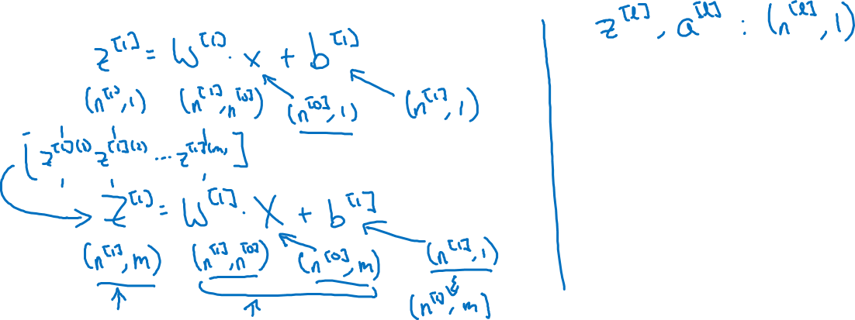
Vectorized implementation
$$x_{1}$$
$$\hat{y}$$
$$x_{2}$$

Slide 4
Deep Neural Networks
Why deep
representations?

Slide 5

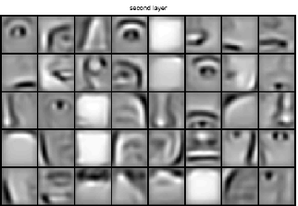
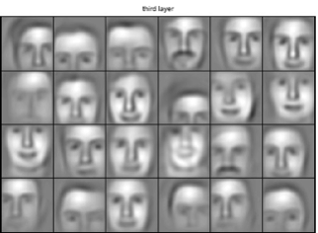

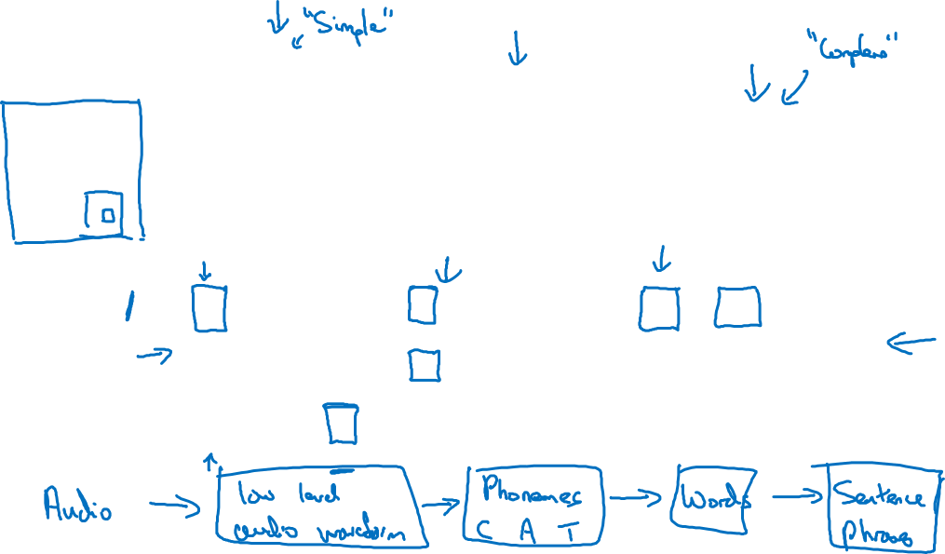
Intuition about deep representation
$$\hat{y}$$

Slide 6
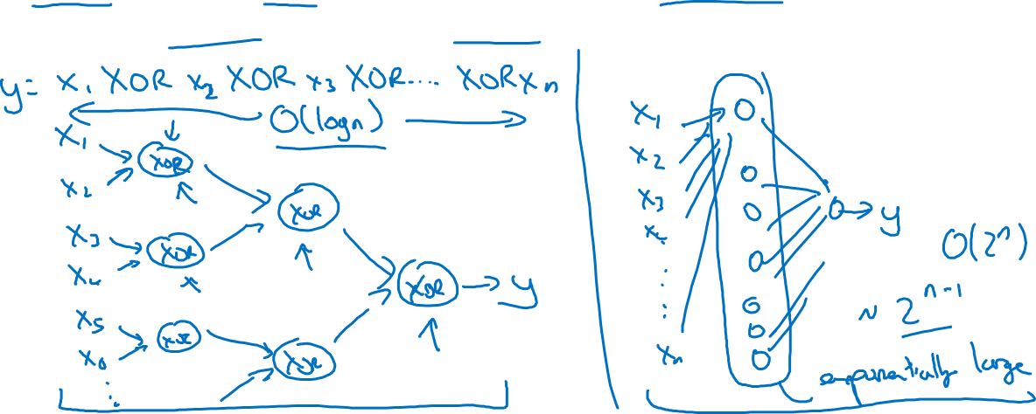
Circuit theory and deep learning
Informally: There are functions you can compute with a “small” L-layer deep neural network that shallower networks require exponentially more hidden units to compute.

Slide 7
Deep Neural Networks
Building blocks of
deep neural networks

Slide 8
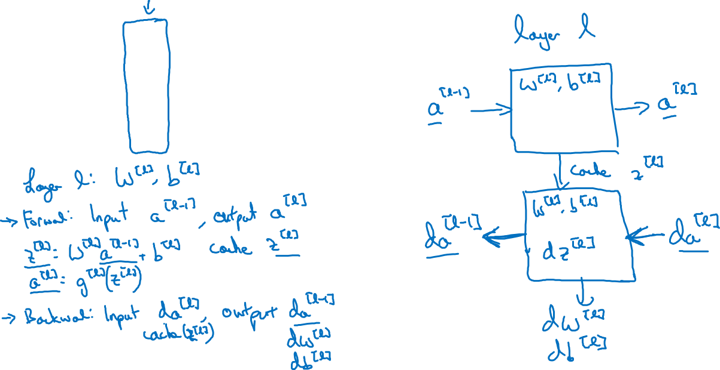






Forward and backward functions
$$x_{1}$$
$$x_{2}$$
$$\hat{y}$$
$$x_{3}$$
$$x_{4}$$

Slide 9
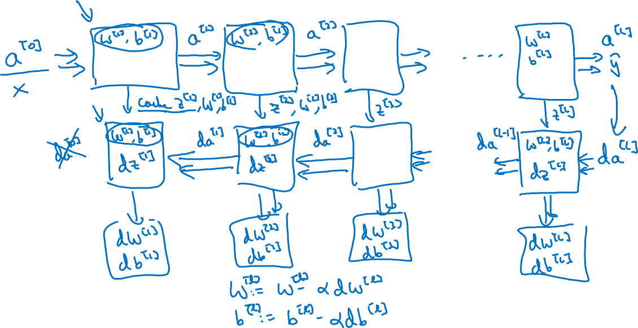
Forward and backward functions

Slide 10
Deep Neural Networks
Forward and backward
propagation

Slide 11
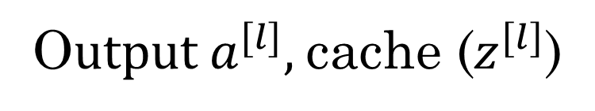
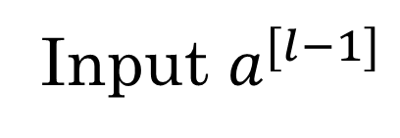
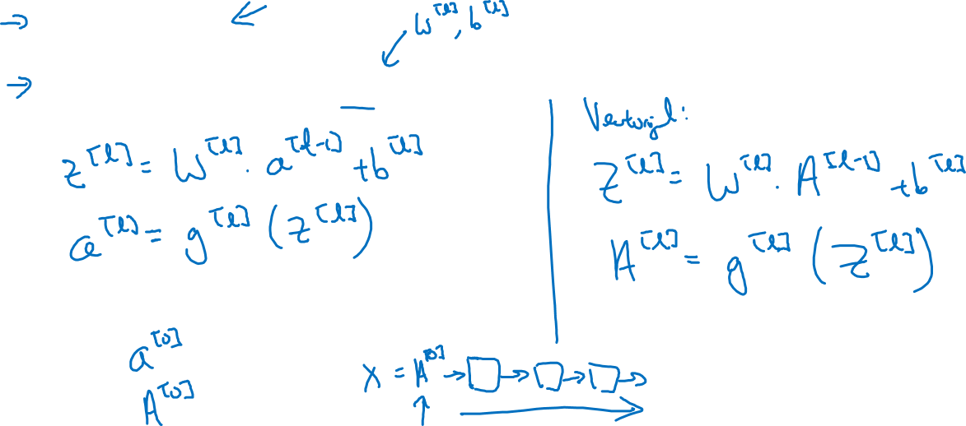
Forward propagation for layer l
Input $a^{[l−1]}$
O$utput a^{[l]},$cache ($z^{[l]}$)

Slide 12
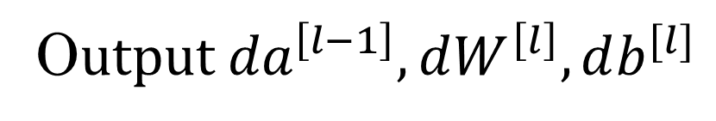
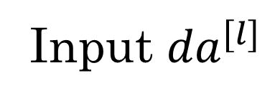
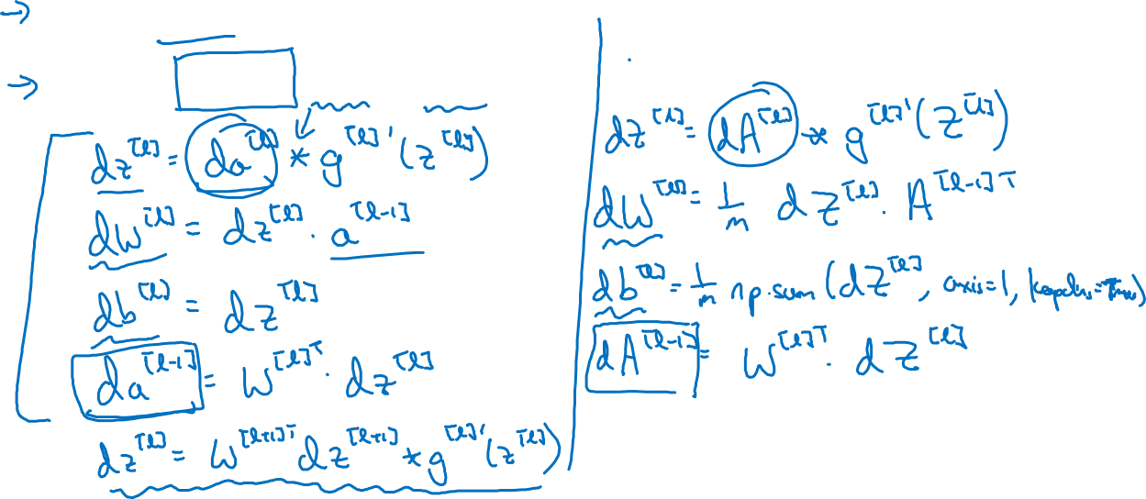
Backward propagation for layer l
Input ${da}^{[l]}$
O$utput {da}^{\left[l−1\right]},dW^{\left[l\right]},db^{[l]}$

Slide 13
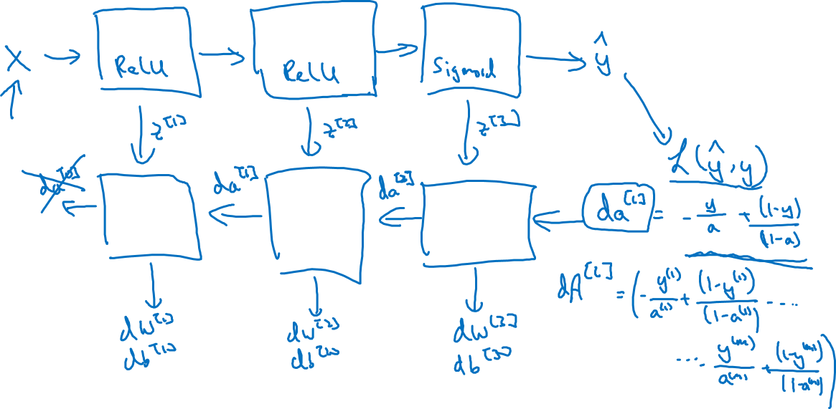
Summary

